Slide 1

JavaScript: Object types:
Ivan Yang
ivan.yang@vml.com
VML Beijing automation learning group

Slide 2


Today
Declare variable
Array type
Object type
Date type
Code demo

Slide 3

JS is a dynamically language
Variables are not typed and can store any data type. It can be converted arbitrarily.
Unlike java need to type conversion or has some inheritance relationships.
Keyword: var/let/const
Variable scope
Variable hoisting
Variable redeclaration
Mutability

Slide 4
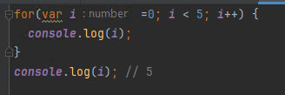
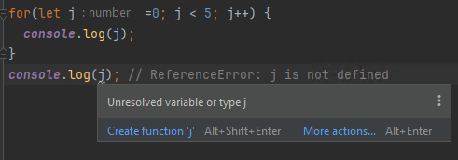

Variable scope
Variables declared with var have function scope or global scope, while those declared with let and const have block scope.
Block scope refers to a code block enclosed by a pair of curly braces, such as if, for, while, try-catch, etc.
VAR
Let/const

Slide 5
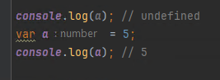
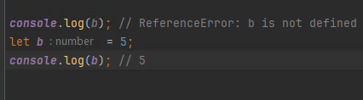
Variable hoisting
Variables declared with var are subject to variable hoisting, which means that variable declarations are moved to the top of the function or global scope, but variable assignments are not hoisted.
Variables declared with let and const are not subject to variable hoisting, and using them before they are declared will result in a ReferenceError.
VAR
Let/const

Slide 6
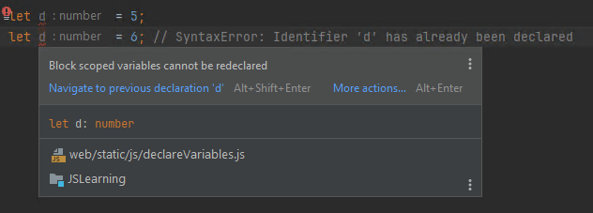
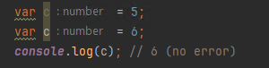
Variable redeclaration
Variables declared with var can be redeclared, and the later declaration will override the previous one.
Variables declared with let and const cannot be redeclared, and attempting to do so will result in a SyntaxError.
VAR
Let/const

Slide 7
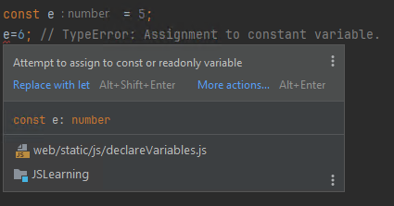
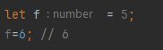
Mutability
Variables declared with var and let are mutable, meaning that their values can be changed after they are assigned.
Variables declared with const are immutable, meaning that their values cannot be changed once they are assigned.
VAR/let
const

Slide 8

Use let/const Not var
Suggestion

Slide 9

Arrays→
Creating Arrays
Accessing elements
Arrays length
Array methods

Slide 10

Array is a special type of object used to represent an ordered collection of data. You can create arrays using array literal syntax or the new Array() constructor. let arr1 = [1,2,3,4,5]; let arr2 = new Array('Tom','Bill','Jake’); let arr3 = [23,32,['a','b','c' [4,5,6]],33]; console.log(arr1); // [1,2,3,4,5] console.log(arr2); // ['Tom','Bill','Jake'] console.log(arr3[2][3][2]);//6
Array
Creating Arrays

Slide 11
You can access and modify elements in an array by their index (starting from 0). let arr3 = ['apple', 'banana', 'cherry']; console.log(arr3[0]); // apple arr3[0] = 'avocado'; console.log(arr3); // ['avocado', 'banana', 'cherry’] The length property is used to get or set the length of an array. let arr4 = [1, 2, 3]; console.log(arr4.length); // Outputs 3 arr4.push(4); console.log(arr4.length); // Outputs 4 arr4.length = 2; console.log(arr4.length); // Outputs 2 console.log(arr4); // Outputs [1, 2]
Array
Accessing Elements/Lenth

Slide 12
Add arr.push(4); // Adds an element to the end of the array arr.unshift(5); // Adds an element to the beginning of the array Delete arr.pop(); // Removes and returns the last element of the array arr.shift(); // Removes and returns the first element of the array Change arr.splice(1, 0, 'a'); // Replaces element at a specified position Find arr[0]; //Find element by index Insert arr.splice(1, 0, 'a', 'b'); // Inserts elements at a specified position
Array
Main methods:

Slide 13
Object→
Creating Objects
Accessing properties
Deleting properties
Object method

Slide 14
You can create objects using object literal syntax or the new Object() constructor. You can access and modify an object's properties using dot notation or bracket notation. let obj1 = {name: 'John', age: 30}; // Object literal syntax let obj2 = new Object(); // Object constructor obj2.name = 'John'; obj2.age = 30; obj1['name'] = ‘Jane’; obj['age'] = 25;
Object
Creating Objects / Accessing Properties

Slide 15
You can use the delete keyword to delete an object's properties. let obj = {name: 'John', age: 30}; delete obj.age; console.log(obj); // Outputs {name: "John"} obj = {}; for (let key in obj) { delete obj[key]; }
Object
Deleting properties

Slide 16
An object's property value can be a function, such properties are known as object methods. let obj = { name: 'John', sayHello: function() { console.log('Hello, ' + this.name); } }; obj.sayHello(); // Outputs "Hello, John"
Object
Object Methods

Slide 17
Date→
Creating Date Objects
Getting Date and Time
Setting Date and Time
Formatting Date and Time

Slide 18
You can create a Date object using the new Date() constructor. If no arguments are passed in, it will create a Date object representing the current date and time. let date1 = new Date(); let date2 = new Date('2019-12-01'); let date3 = new Date('2019-12-01T12:00:00'); let date4 = new Date(2019, 11, 1, 12, 0, 0, 0); let date5 = new Date(63768960000000);
Date
Creating Date Objects

Slide 19
The Date object provides several methods to get various parts of the date and time, such as year, month, day, hour, minute, second, etc. let now = new Date(); console.log(now.getFullYear()); //Year console.log(now.getMonth()); //Month(0-11) console.log(now.getDate()); //Day(1-31) console.log(now.getHours()); //Hour(0-23) console.log(now.getMinutes()); //Minute(0-59) console.log(now.getSeconds()); //Second(0-59) console.log(now.getMilliseconds()); //Millisecond(0-999) console.log(now.getTime()); //Get milliseconds since 1970.1.1 0:0:0 UTC
Date
Getting Date and Time

Slide 20
The Date object also provides several methods to set various parts of the date and time. let date = new Date(); date.setFullYear(2024); date.setMonth(0); date.setDate(1); date.setHours(0); date.setMinutes(0); date.setSeconds(0); date.setMilliseconds(0); date.setFullYear(2024,0,1); date.setHourd(12,0,0,0);
Date
Setting Date and Time

Slide 21
You can use the toLocaleDateString, toLocaleTimeString, and toLocaleString methods to format the date and time. let now = new Date(); console.log(now.toLocaleDateString()); // Outputs the date in "yyyy/mm/dd" format console.log(now.toLocaleTimeString()); // Outputs the time in "hh:mm:ss" format console.log(now.toLocaleString()); // Outputs the date and time in "yyyy/mm/dd hh:mm:ss" format
Date
Formatting Date and Time

Slide 22
Code Demo
5.0
https://github.com/ivanyangWTC/JSLearning
https://github.com/ivanyangWTC/JSLearning.git

Slide 23

Thanks & Questions

